Slide 1


Welcome to Fingerprint door lock system
Sr.No | UNR NO | NAME
1 | 2020-B-07012002 | RITESH OJHA
2 | 2020-B-02062002 | PALLAVI KUMARI
3 | NIL | RAAJ SINGH RAWAT
4 | 2020-B-05112001A | SHUBHAM MUSMADE
GOLF Procedures
World’s Best Door lock

Slide 2

Normal Door Lock
Access is not fast
Key lost problem
Duplicate key
Medium Privacy level
1
2
3
4

Slide 3


What things do we need in our new Door system
1
High level Privacy
Fast Access
Unique Identity
Two-step verification
Limited Entry
2
3
4
5

Slide 4

FINGERPRINT DOOR LOCK SYSTEM
1
No more key lost
No duplicate key
User friendly
Two-step verification
Stable through out a day
Highly Secure
Quick access
2
3
4
5
6
7

Slide 5

Progress
Successfully Completed and Tested

Slide 6
THING WHICH WE REQUIRED FOR OUR PROJRCT
Arduino
LCD display
Relay Module
7-12V power source
Fingerprint sensor
Buzzer

Slide 7


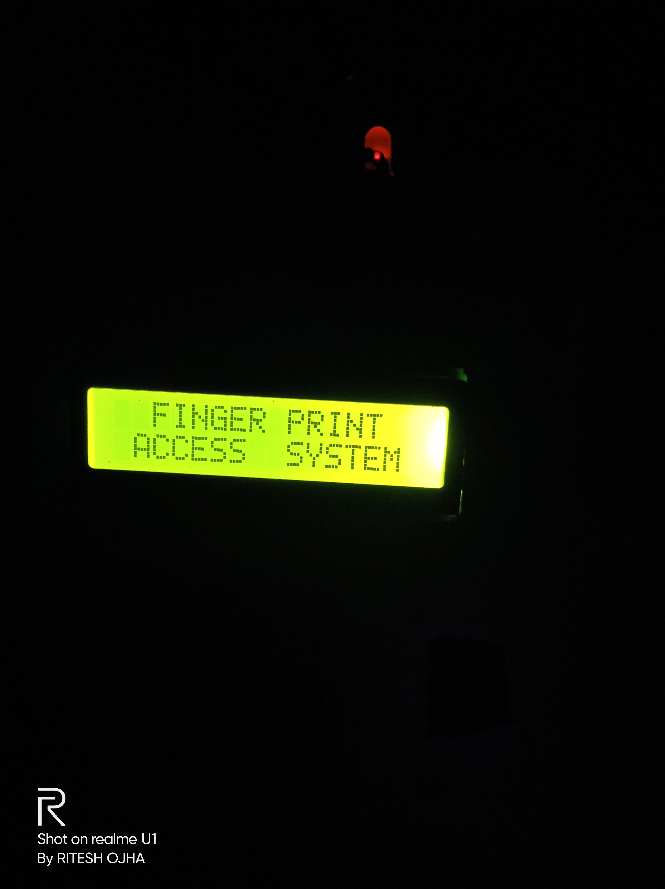

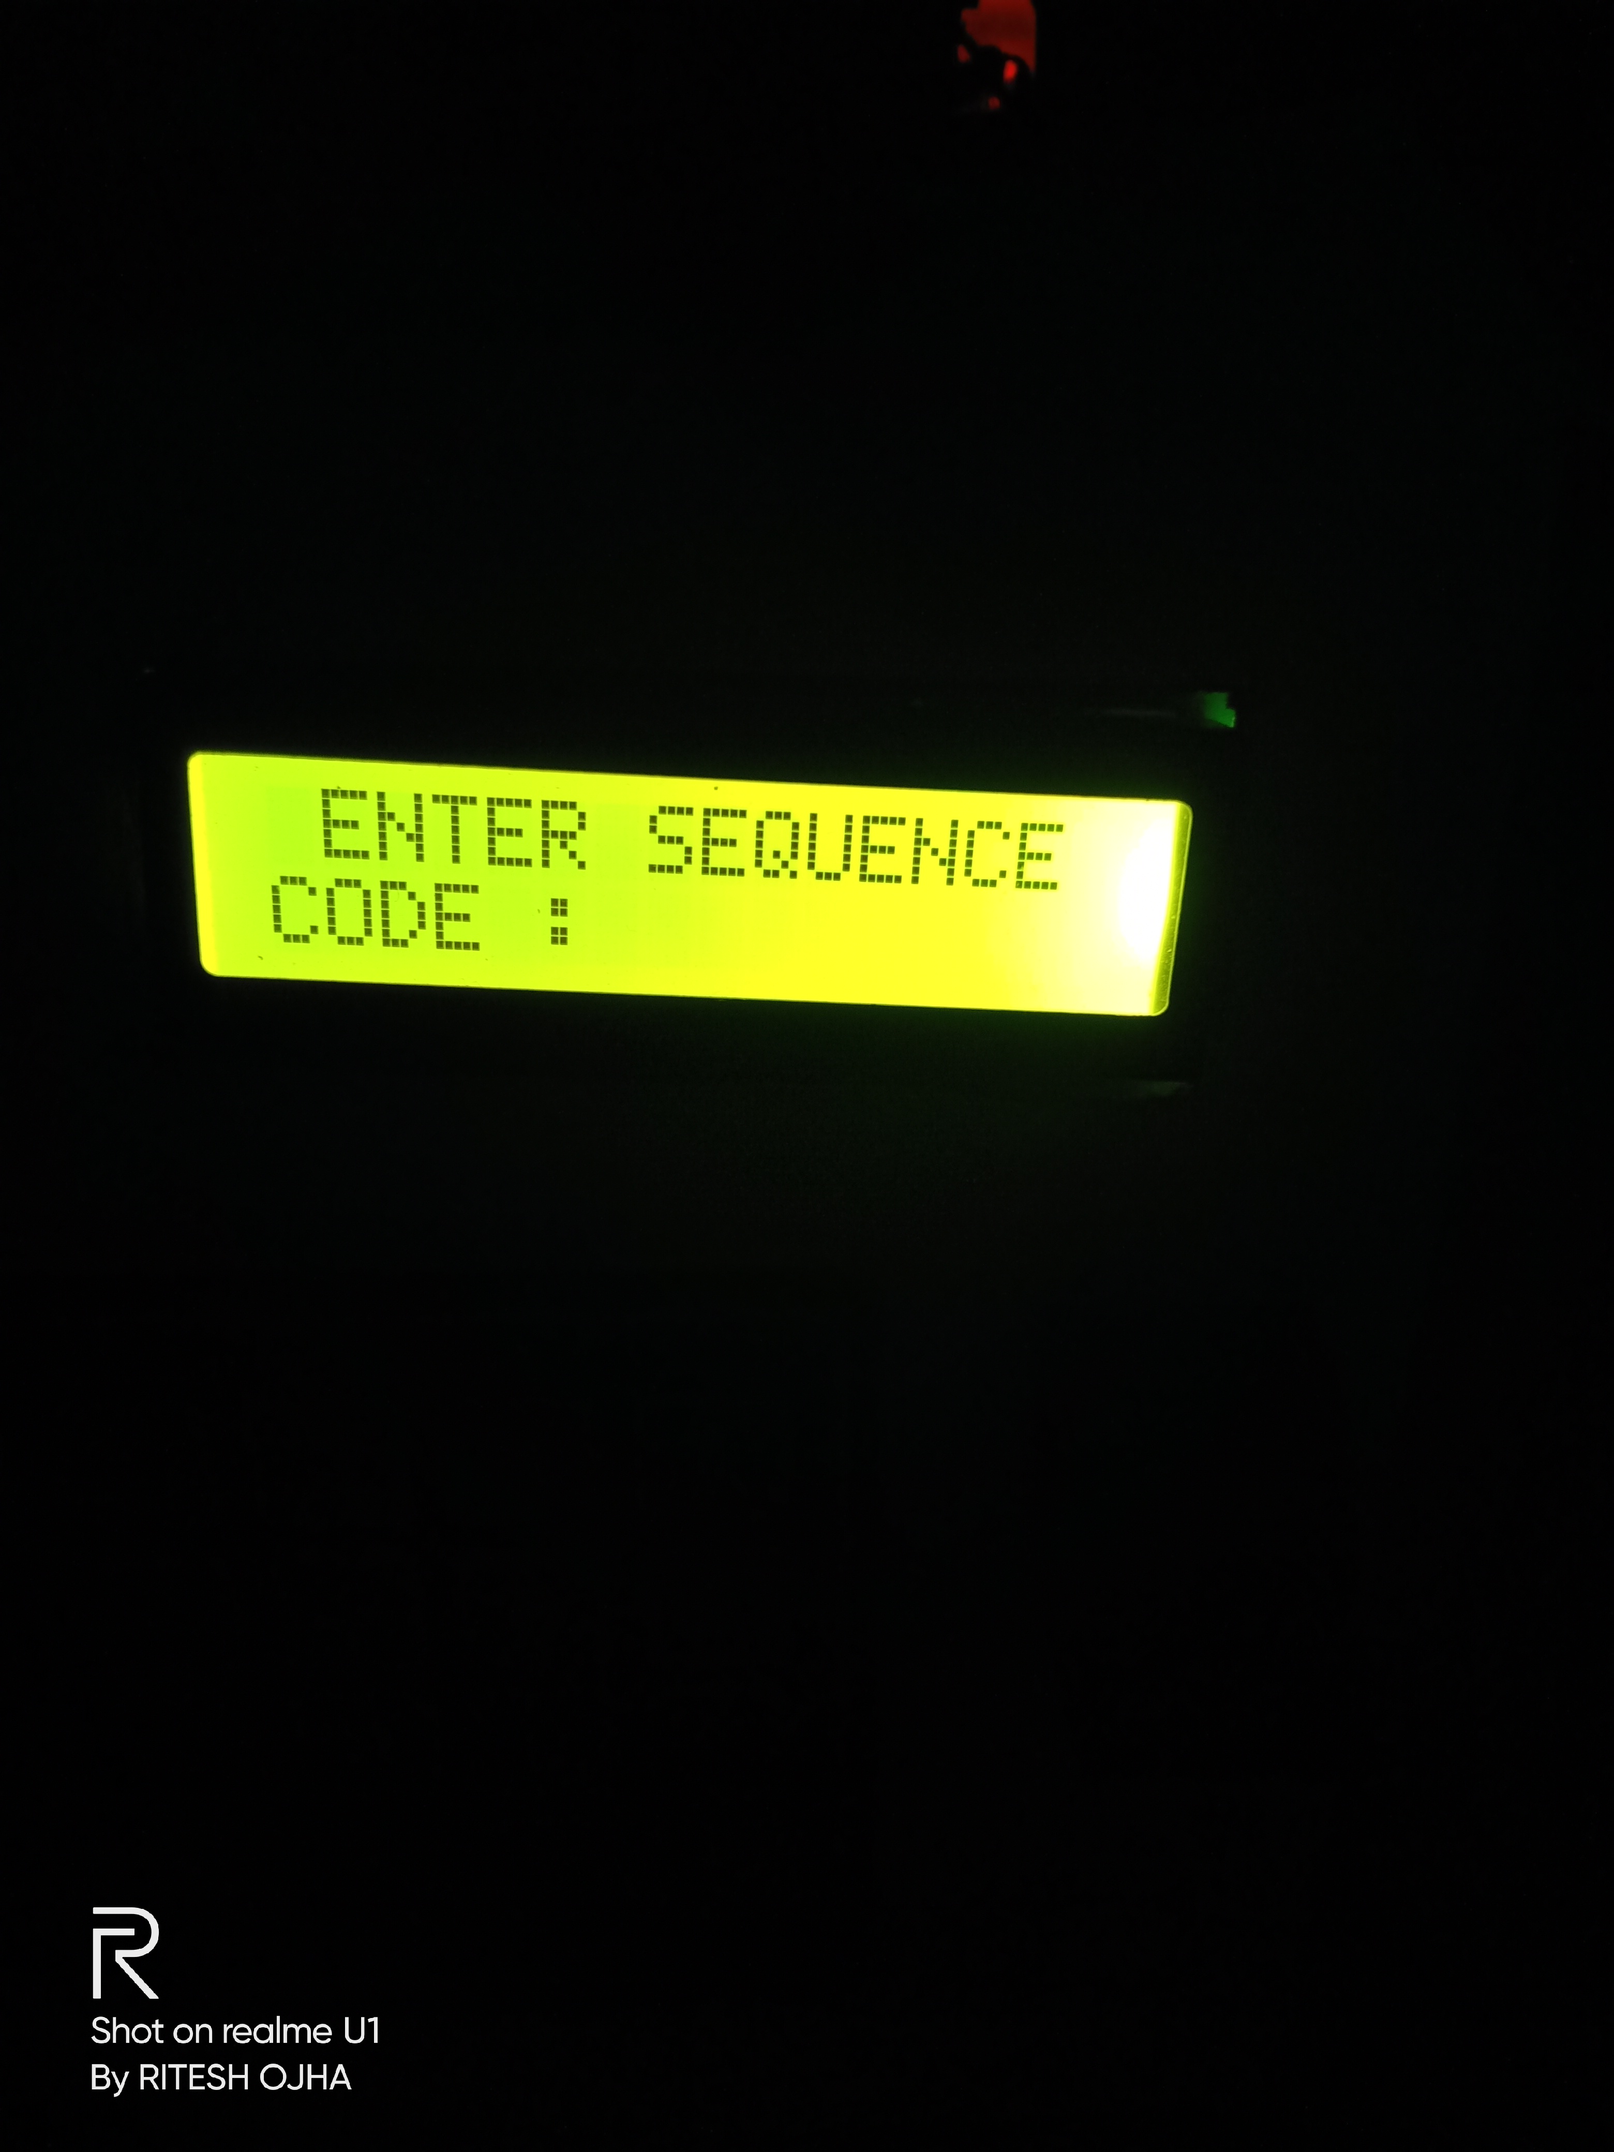
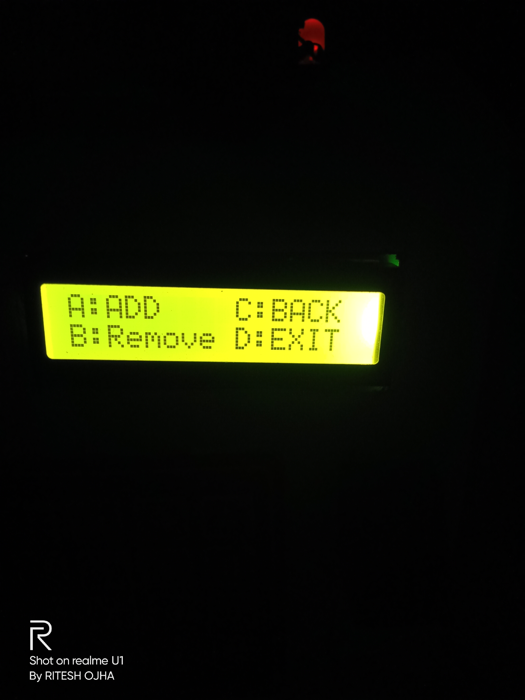
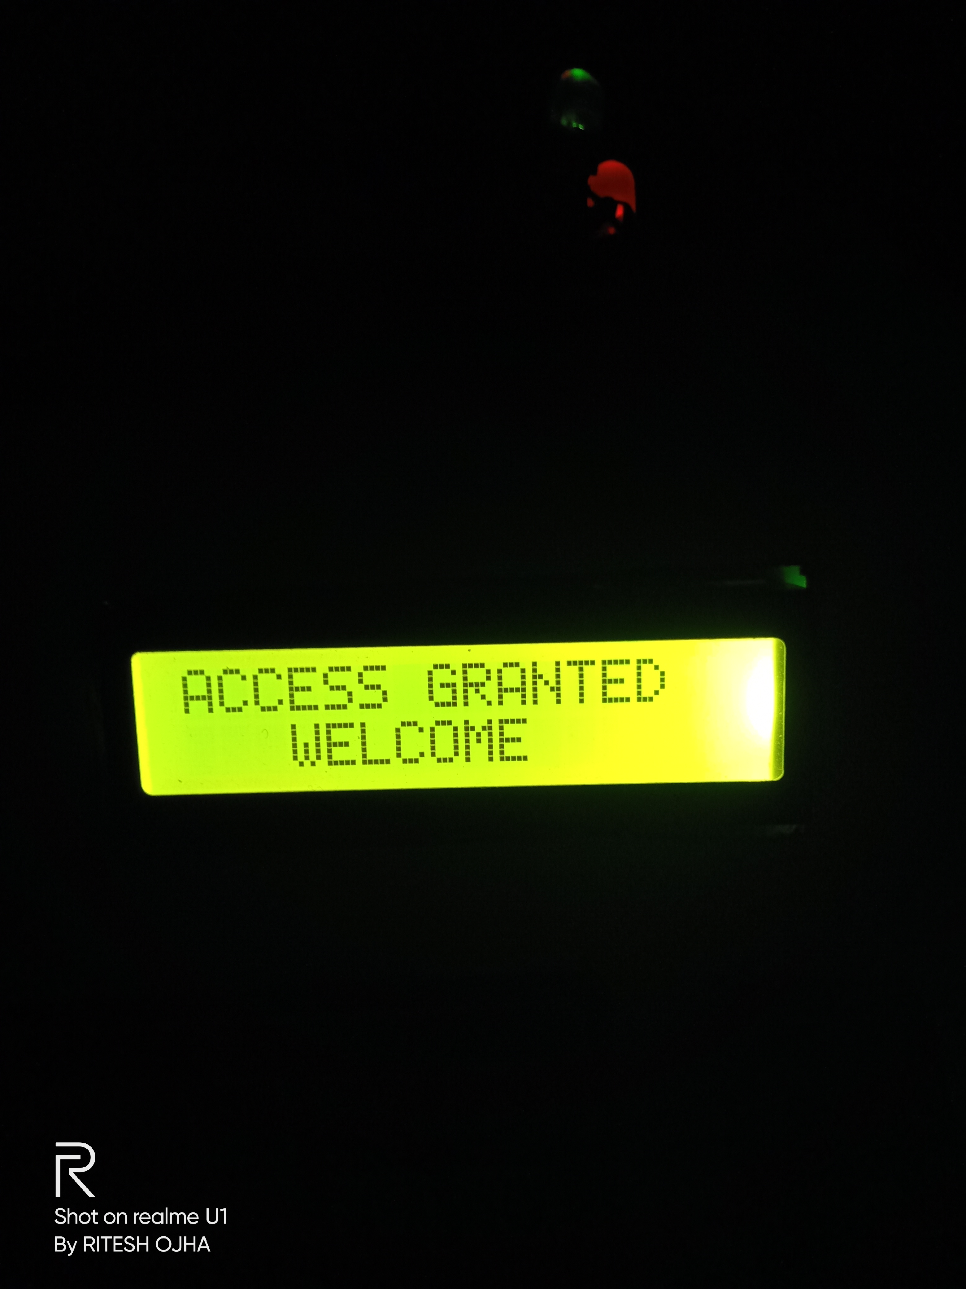
How To Use
For the first time it ask you to register your self by entering Sequence.
During registration it will ask you for second finger for two step verification.
Ones you finish the registration you can easily access the lock.

Slide 8
THANK YOU

